Slide 1



Commands in SQL
www.linkedin.com/in/chandankumar432

Slide 2
Introduction
SQL stand for Structure Query Language.
SQL is a structured language for accessing and manipulating database.
SQL commend are kind of instructions that enables SQL to perform task as creating a table, adding , data to table, dropping a table, modifying a table, set restrictions for users, etc…
There are five types of SQL commands:
DDL – Data Definition Language.
DCL- Data Control Language.
DQL- Data Query Language.
DML- Data Manipulating Language.
TCL- Transaction Control Language.
www.linkedin.com/in/chandankumar432

Slide 3
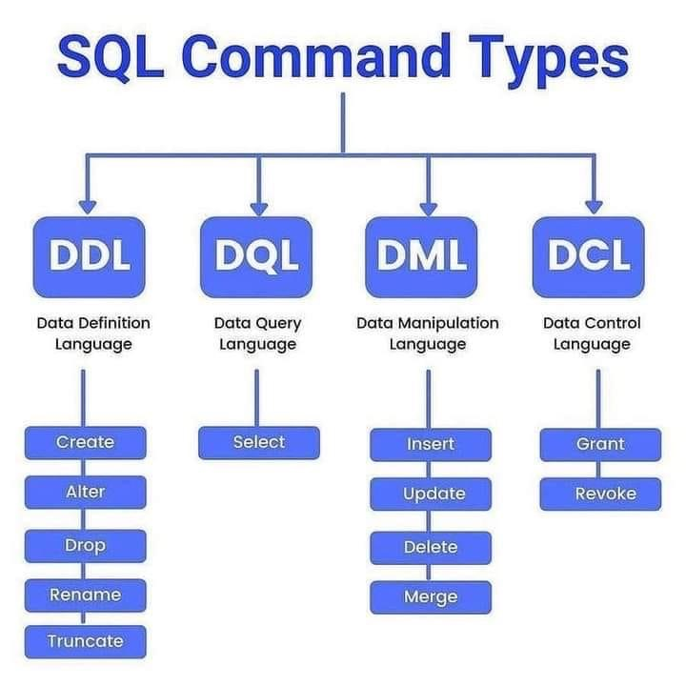
www.linkedin.com/in/chandankumar432

Slide 4
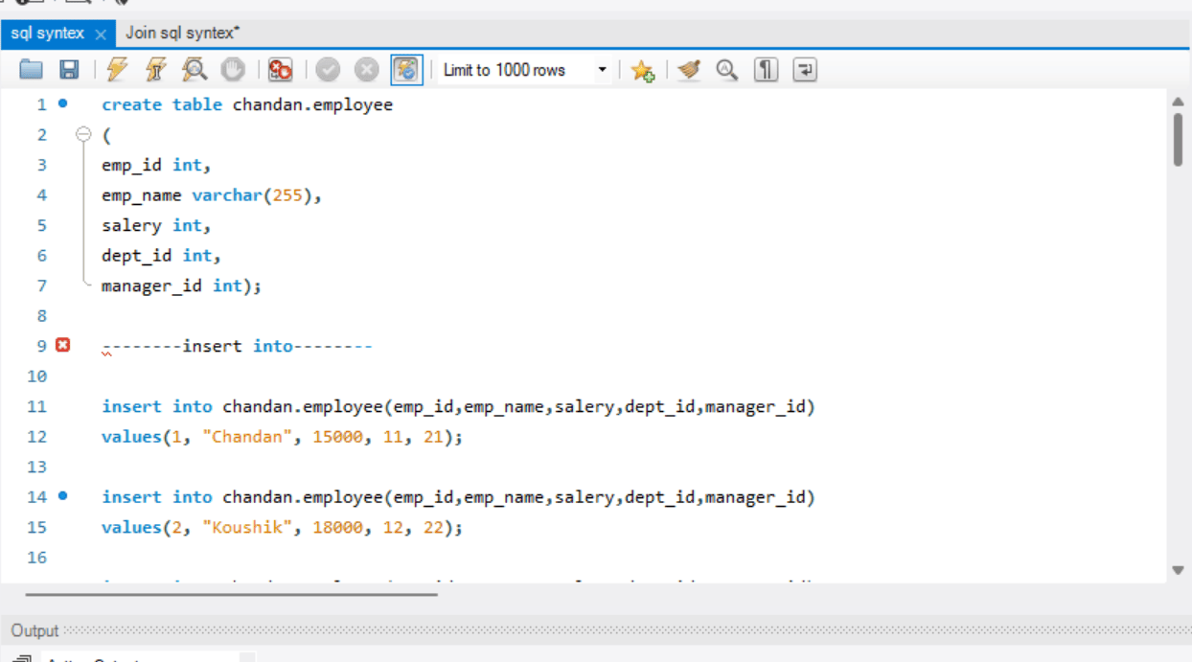
DDL
DDL stand for Data Definition Language.
It help in creating table, modulation of table, deleting table from database as well as deleting all the records of the table. The changes made by DDL commands are permanent in the database.
Create is used to create tables. It contains datatype and constraints. Datatype refers to the rules applicable for particular column like INT, VARCHAR,CHAR etc. While constraints refers to the restrictions or limitations in particular column like Not NULL, Unique, Primary Key, Foreign Key, Check.
www.linkedin.com/in/chandankumar432

Slide 5
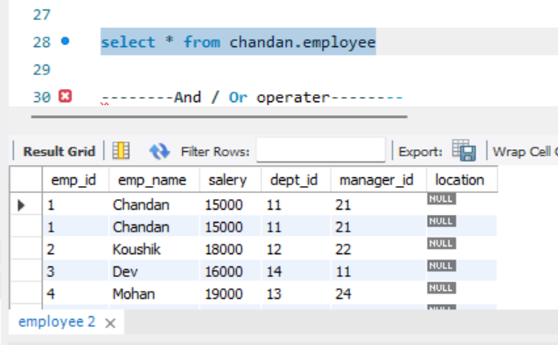
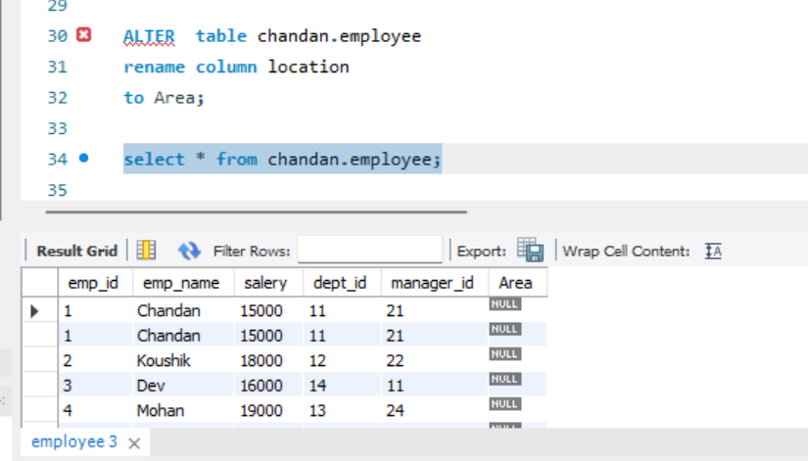
DDL
Alter is used to modify a table. Like changing name of the column, changing name of the table etc.
www.linkedin.com/in/chandankumar432

Slide 6
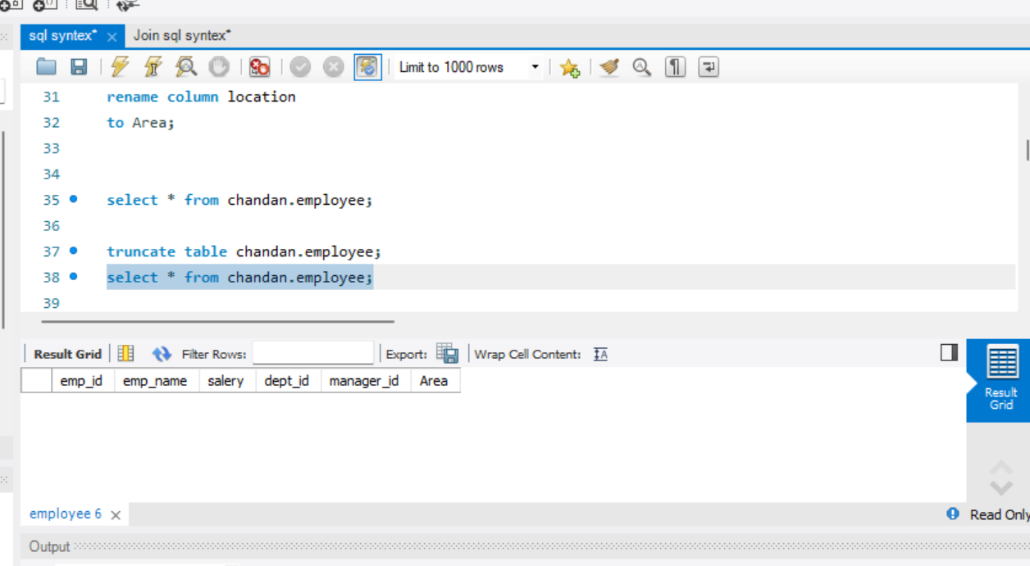
DDL
Truncate : Is used to delete all the record of the table at once.
www.linkedin.com/in/chandankumar432
Drop: is used to drop/delete a table from the database.

Slide 7
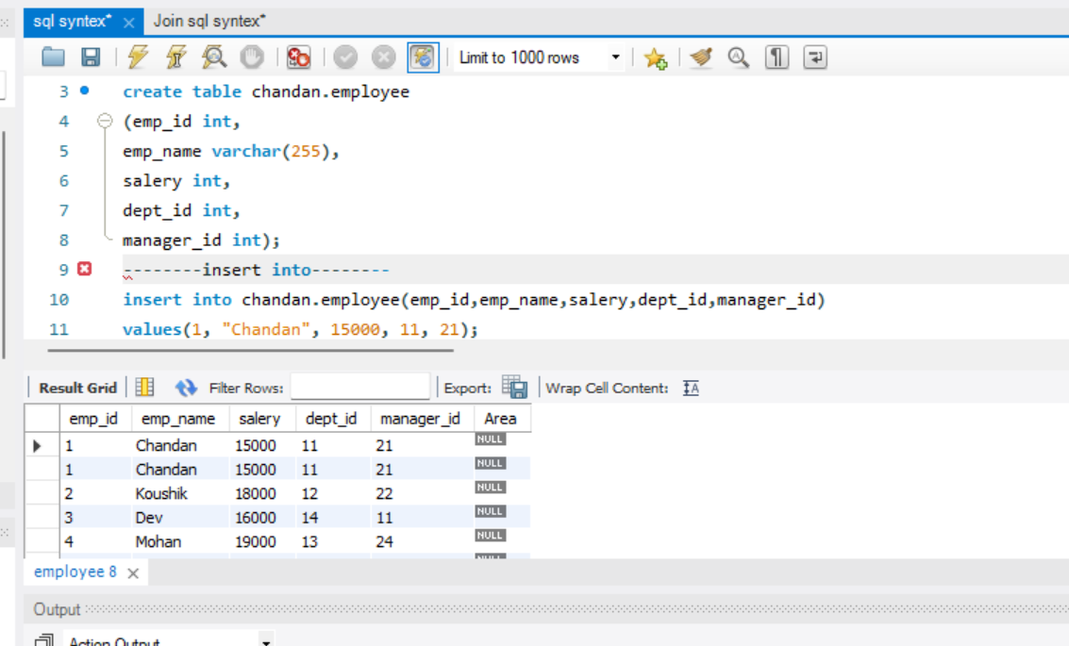
DML
DML stands for Data Manipulation Language .it help in loading , modifying , removing data in the database. The changes made using these commands can be rolled back.
Insert is used to load data.
www.linkedin.com/in/chandankumar432

Slide 8
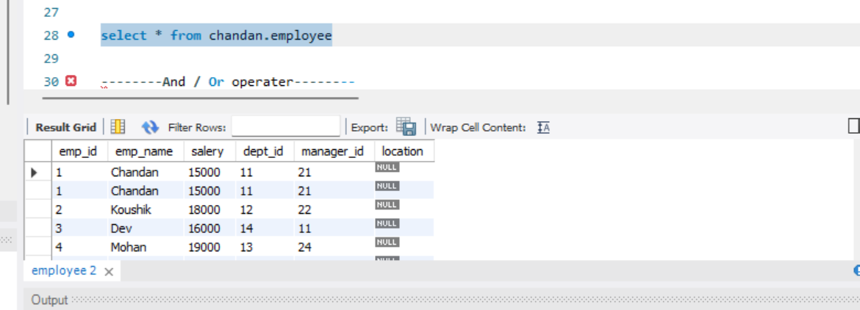
DML
Update : is used to modify the existing data.
www.linkedin.com/in/chandankumar432

Slide 9
DML
Delate is used to delate rows from the table one at a time.
www.linkedin.com/in/chandankumar432

Slide 10
DCL
DCL stand for Data Control Language.
It is used to grant or revoke authority from the user.
Grant gives permission to the users.
Revoke takes back permission from the users.
www.linkedin.com/in/chandankumar432

Slide 11
TCL
TCL stand for Transaction Control Language.
These are used with DML commands and are automatically committed in the database.
Commit is used to save the change after DML operations.
Rollback is used to undo the changes.
Savepoint saves changes upto certain points.
www.linkedin.com/in/chandankumar432

Slide 12
DQL
DQL stand for Data Query Language.
This is used to fetch fata from dataset.
Select data based on certain conditions or aggregations or filters.
www.linkedin.com/in/chandankumar432

Slide 13

Thank you

